Slide 2
WELCOME RTMA GUESTS

Slide 3
APRIL MONTHLY MEETING
TOPIC: Commercial & Industrial Energy
Rebates
SPEAKER: Carl Ceccanti, Energy Advisor,
Franklin Energy

Slide 4
2024 Program Overview
2024 Program
Non-Residential
Rebate Programs

Slide 5
Agenda
Safety Moment
Program Overview
Program Basics
How to apply
2023 Highlights
What’s New for 2024
Enhanced Rebates for Lighting
Intro to New Programs
Program Budgets
2024 Program Kick-off

Slide 6
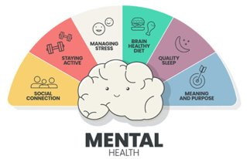
Safety Moment
Winter Blues or Seasonal Affective Disorder (SAD)
Symptoms Include
Fatigue, difficulty concentrating, social withdrawal, and depression
Stress Management
Identify Stressors
Set Realistic Goals
Learn to Say No
Diet and Exercise
Mindfulness Practices
Seek Professional Help
Additional Resources:
Investigate services available through your insurance provider or company benefits offerings
Mental Health At Work, NYS DOL
National Institute of Mental Health
2024 Program Kick-off
Commercial & Industrial Rebate Programs
Notes:
The winter season includes shorter days and less sunlight can impact mood and energy levels
Identify Stressors - understanding stress triggers is the first step in managing it
Set Realistic Goals - break larger tasks into smaller, more manageable goals. This can make tasks feel less overwhelming
Learn to Say No - understand your limits and don’t be afraid to decline additional responsibilities
Diet and Exercise - a healthy lifestyle can contribute to better resilience, physical activity is a natural stress reliever
Mindfulness Practices - mindfulness and relaxation practices such as yoga, meditation, or deep breathing can help focus your mind and reduce stress
Seek Professional Help - if stress becomes overwhelming or persistent, consider seeking support from a mental health professional who can provide guidance and coping strategies tailored to your situation

Slide 7
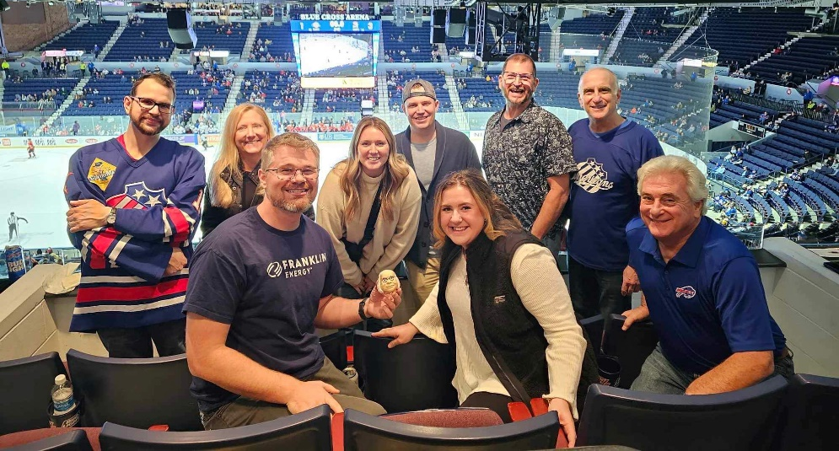
Program Implementer
Contact Info
Email: cienergysavings@franklinenergy.com
Phone: 1.888.316.8023
2024 Program Kick-off

Slide 8
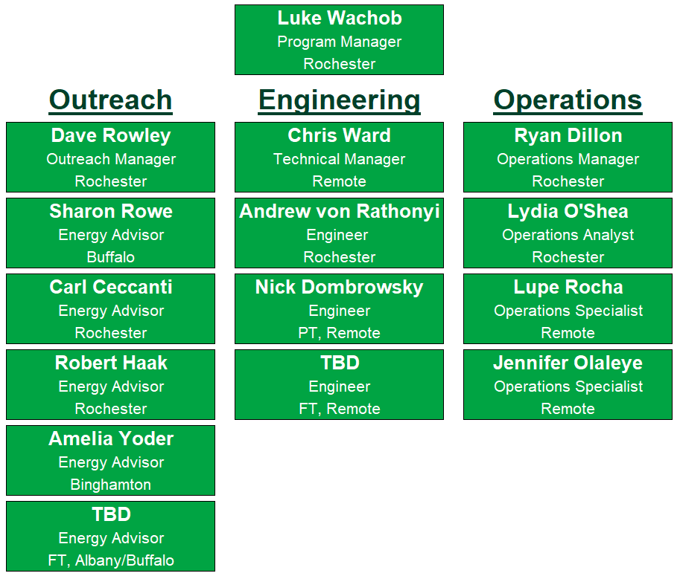
NYSEG/RG&E Rebate Team
2024 Program Kick-off

Slide 9
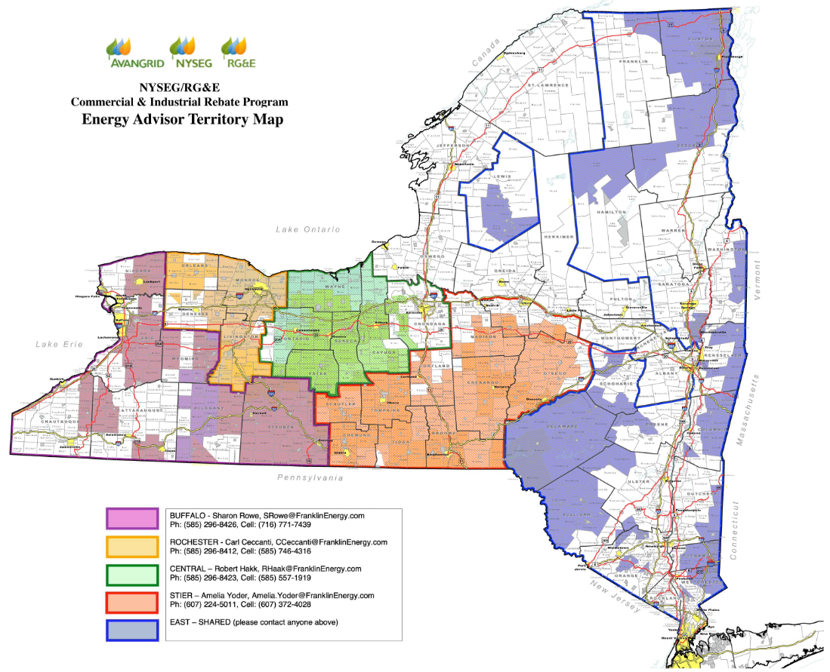
NYSEG/RG&E Service Territory
2024 Program Kick-off

Slide 10
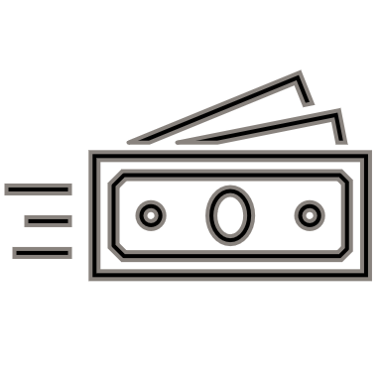
Program Overview
What are the Energy Efficiency Incentive Programs?
Incentives for Non-Residential NYSEG and/or RG&E customers for facility upgrades or the installation of equipment that results in lasting energy savings
Eligible customers include Commercial, Industrial, Small Business, Government and Municipalities, Agricultural
Retrofits/Add-ons to Existing Buildings, Major Renovation and New Construction Projects
Does NOT include Residential, Multifamily, Renewable Energy, or Heat Pump Applications
2024 Program Kick-off

Slide 11
Program Structure
Non-Residential Energy Efficiency
Program Portfolio
Mature Programs
Commercial and Industrial (C&I) Rebates Program, 2016
Small Business (SB) Rebates Program, since 2022
New in 2024!
Instant Discount Program
Retro-Commissioning Program (RCx)
Energy Management Partnership Program (EMP)
2024 Program Kick-off

Slide 12
C&I Rebate Program
Provides rebates to utility customers who perform energy efficiency upgrades to their facilities and/or equipment
Prescriptive – predetermined rebate amounts for eligible equipment
Preapproval is optional
90-day lookback window for completed work
Custom – performance-based rebates, calculations required
$0.20/kWh saved annually
$1.50/therms saved annually
Preapproval is required
NYSEG and RG&E offerings are identical
No min or max rebate amount, some caps for Custom applications
Rebates are paid after project is completed
Flexible payment options
We’ll pay up to 50% of the project cost!
2024 Program Kick-off

Slide 13
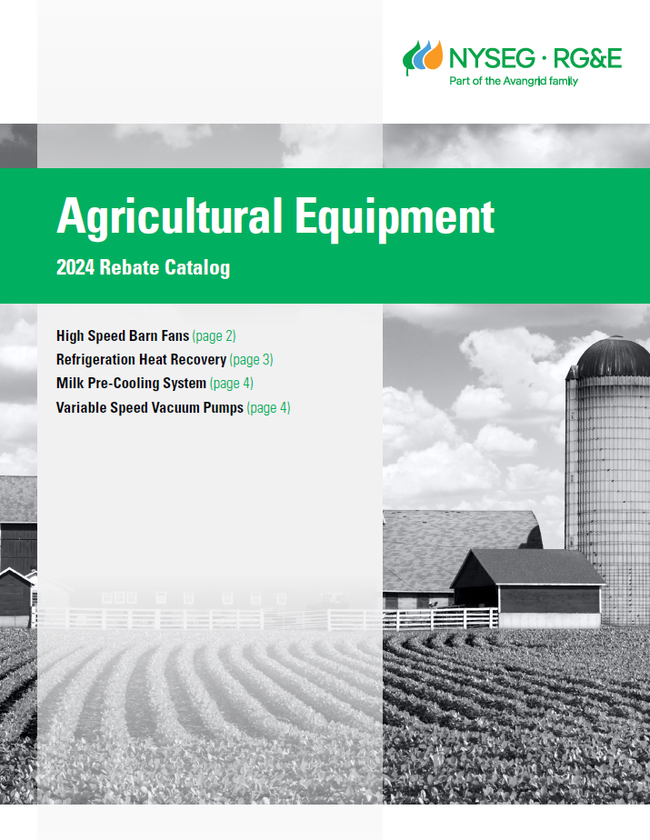
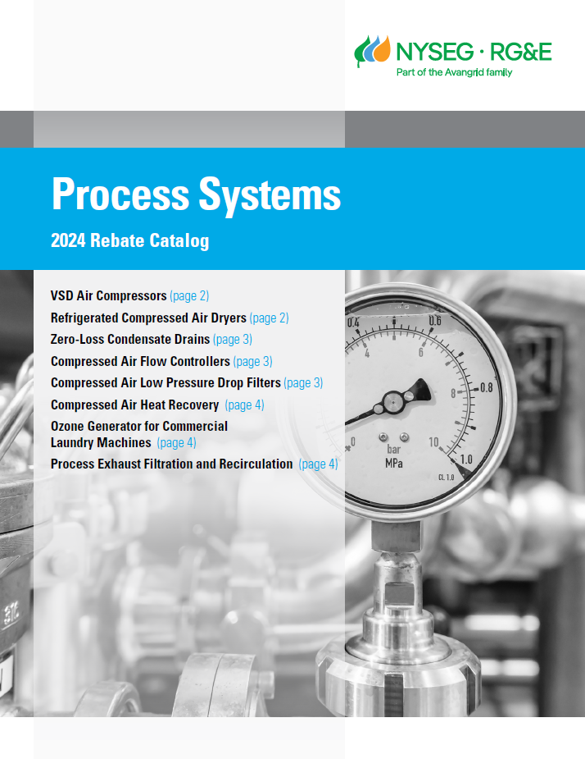
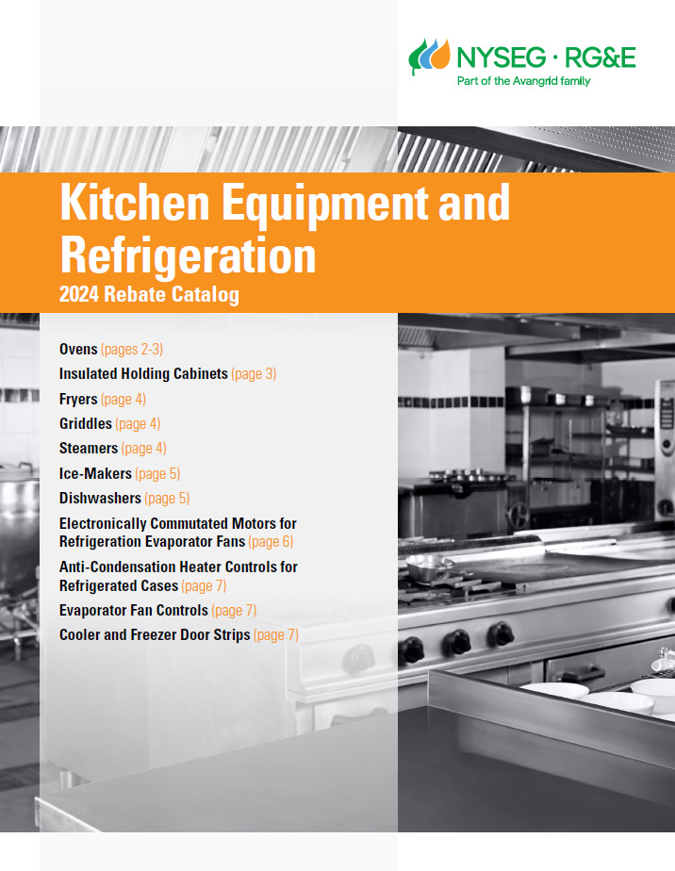
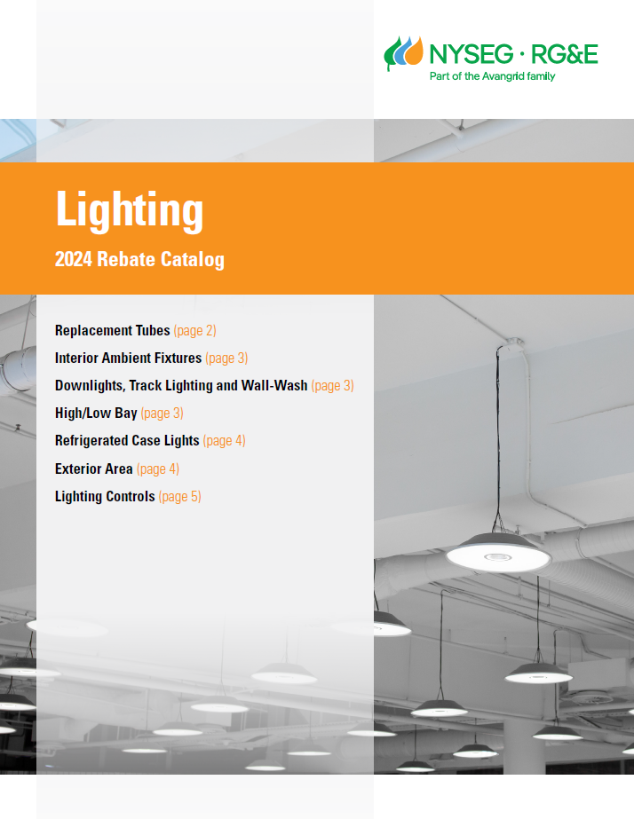
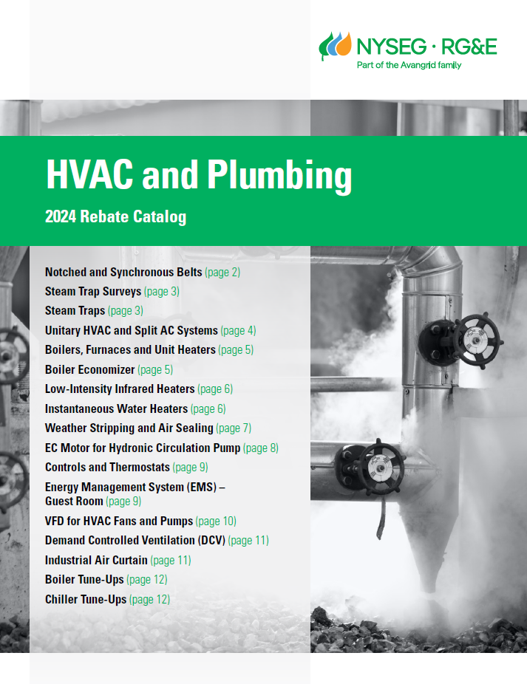
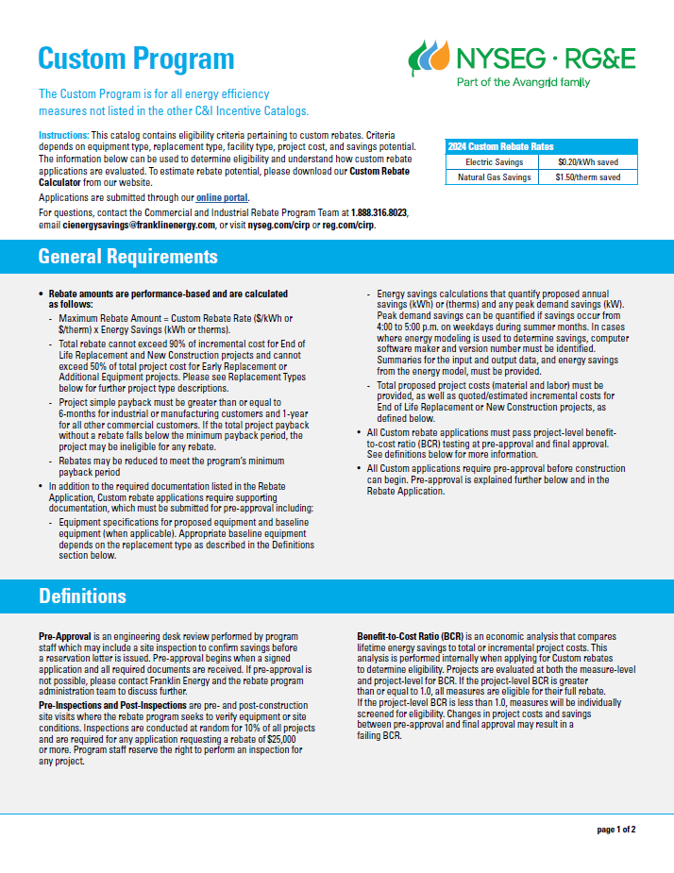
C&I Rebate Program Catalogs
2024 Program Kick-off

Slide 14
C&I and SB Application Process
Visit the program website for all information
Confirm Project Eligibility and Type
Apply Online –
Get Pre-Approved (required for custom, or as desired)
Execute Project
Submit Final Documents Online and Get Your Rebate
Notes:
Contact program staff with any questions or for a demo on the application process
Watch our 2023 webinar recording on How to Apply
ACH bank transfer payment option in the works for 2024
RGE.com/CIRP NYSEG.com/CIRP | RGE.com/SBRP NYSEG.com/SBRP | nysegrgeta.com
2024 Program Kick-off
Notes:
Luke to drop a link in the chat

Slide 15
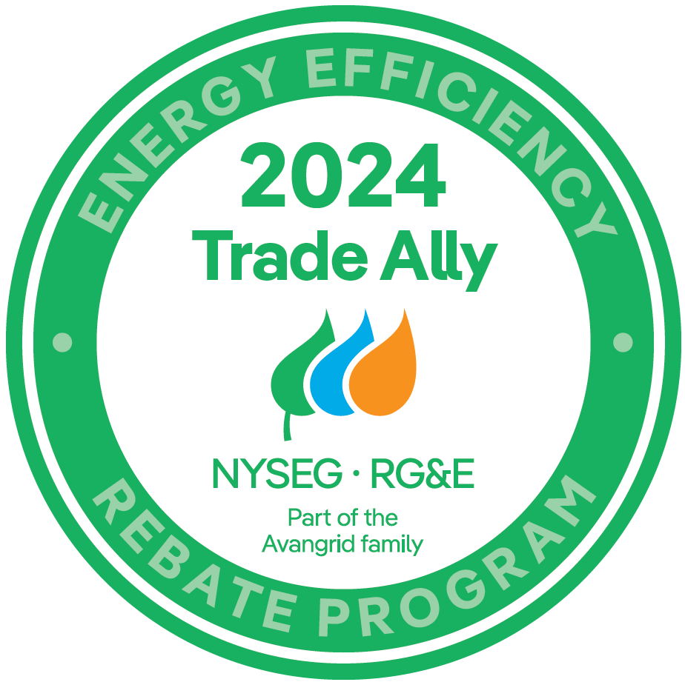
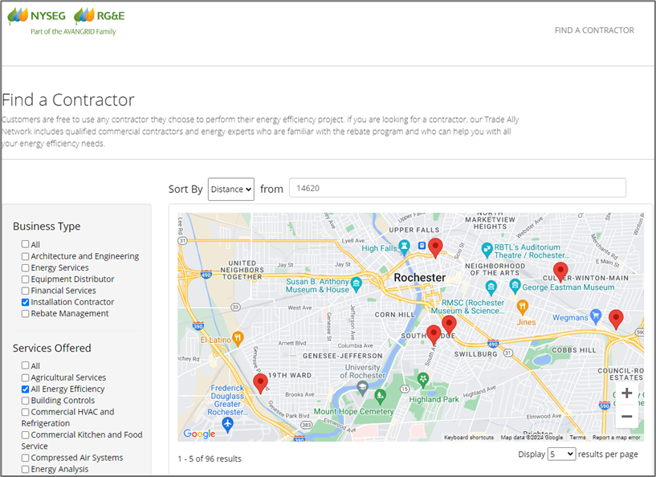
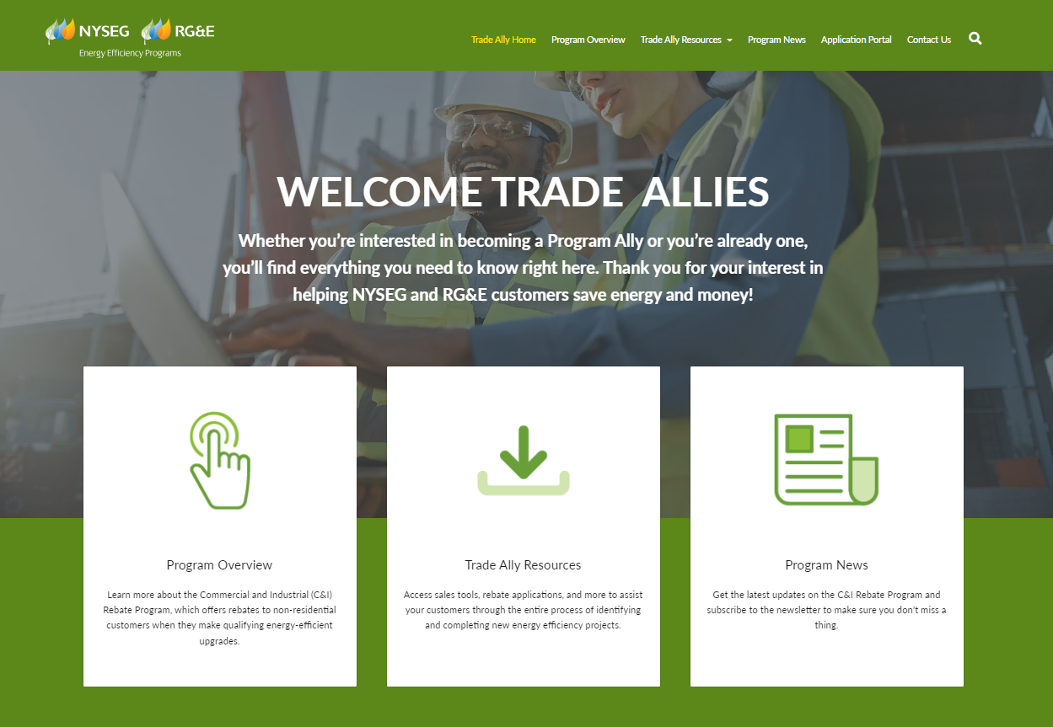
C&I and SB Contractors
Trade Ally Network
Find a Contractor Tool
Do Not Copy
nysegrgeta.com
74% of all projects in 2023 were submitted by Trade Allys
2024 Program Kick-off
Notes:
Define “Trade Ally”
262 Registered TAs

Slide 16
Enhanced C&I Lighting Offerings for 2024
LED lighting not eligible for rebates starting in 2026
NYS PSC Case 18-M-0084
7/20/23 Order
Statewide, C&I, SB, MF, Res
How NYSEG and RG&E are Responding
50+% Increase on LED Rebates Effective Feb 1st
Guaranteed through 2024 while funds are available
Existing unpaid applications will be included
NGAGE Portal will be updated to reflect new amounts
Shift Program Focus Toward Non-Lighting
2024 Program Kick-off

Slide 17
New Programs for 2024
Retro-Commissioning Program
Definition
RCx is a systematic process applied to an existing building’s mechanical and electrical systems to ensure energy performance and operations in accordance with the owner’s needs
Customer Journey
Customer Selects their Technical Service Provider (TSP)
TSP Performs RCx Study
Customer Selects Measures for Implementation
Customer Implements Measures ($5,000 min for large customers)
Validate Savings
Customer Receives additional Rebate for Savings
Three RCx Participant Types:
Large Industrial: defined by mechanical systems and capacities
Large Commercial: > 100,000 square feet
Express Building Tune-Up: < 100,000 square feet
2024 Program Kick-off
Notes:
This is another program that we will be partnering with another implementor on to deliver. For engaged customers and contractors, you’ll be working with Energy Infrastructure Partners (EIP). They’ve been in the
A retrocommissioning Study will identify areas where a building’s operational parameters have fallen outside the original intent or design of the building.
For large customers we’re targeting systems like chillers, boilers, hair handling units, packaged HVAC equipment, lighting, and controls. Also, any process system including refrigeration equipment and compressed air.
For the smaller buildings we’ll focus on controls, setpoints, plug loads, as well as the HVAC and lighting equipment,

Slide 18
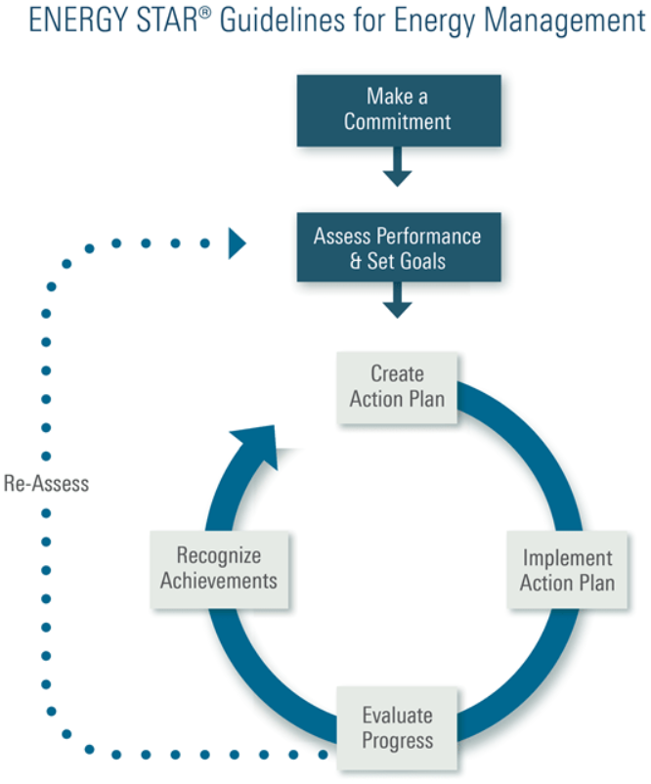
New Programs for 2024
Energy Management Partnership Program
Definition
The EMP Program offers a wholistic approach to energy management that incorporates energy efficiency into an organization’s daily operations, promoting a culture of continuous improvement in energy improvement and sustainability.
Intent
Teach customers to leverage existing internal resources and teams to build new processes that identify and implement low-cost and behavioral energy savings measures.
Two EMP Participant Types
Commercial: 2+ GWh of electric use
Industrial: 3+ GWh of electric use
Activities Included
• Coaching Sessions • On-site Staff Training
• Peer-to-peer Workshops • On-site Treasure Hunts
2024 Program Kick-off

Slide 19
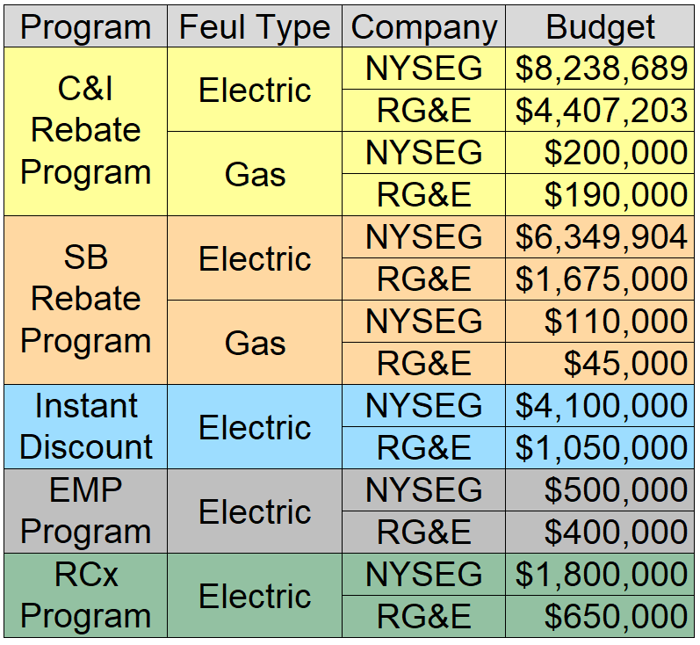
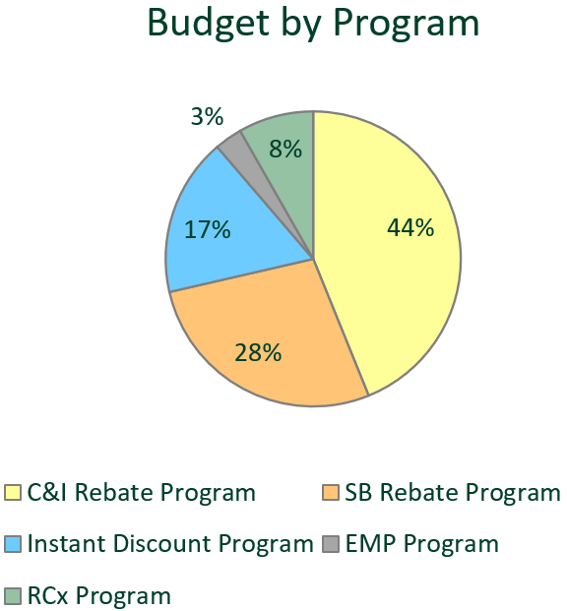
Non-Residential Program Budgets
67% Budget Increase Over 2023!
Subject to Change
2024 Program Kick-off
Notes:
C&I, $13M+
SB, $8M+
Instant Discount, $5M
EMP + RCx, $3M
Fewer Gas savings dollars this year, but NYSEG/RG&E is already working on getting those increased too

Slide 20
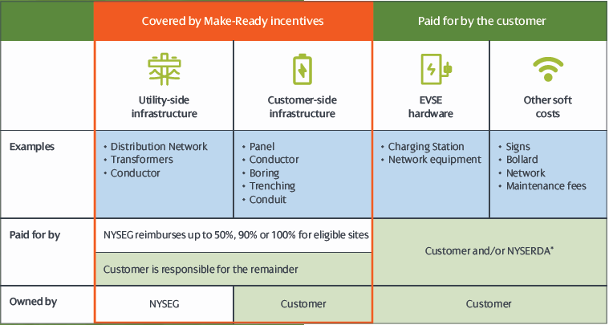
EV Charger Make-Ready Program
Rebates are available to help offset up to 90-100% of construction costs associated with the electrical infrastructure (make-ready) required to support L2 and DCFC chargers for commercial customers.
Websites:
NYSEG EV Make-Ready
RG&E EV Make-Ready
​
Program Contact:
Chris Wallace​
Email: cwallace@franklinenergy.com​
Phone: 607-203-5509​
Commercial & Industrial Rebate Programs
Notes:
New platform -> less splitting and less paperwork! 1Q22
App consolidation (pres/custom, elec/gas)
Web-based calculator tools
“True” prescriptive lighting – 1Q22
Simplifies app, eliminates calculator, faster turnaround
Deemed values: baseline wattages, project costs
Run hours by building type

Slide 21
Connect with our team:
Name | Phone | Email
Sharon Rowe (Buffalo) | 585-296-8426 | srowe@franklinenergy.com
Carl Ceccanti (Rochester) | 585-296-8412 | cceccanti@franklinenergy.com
Robert Haak (Central) | 585-296-8423 | rhaak@franklinenergy.com
Amelia Yoder (South) | 607-224-5011 | amelia.yoder@franklinenergy.com
Non-Residential Rebate Programs Team ​
Email: cienergysavings@franklinenergy.com​
Phone:1.888.316.8023​
Thank you!
2024 Program Kick-off
Notes:
Andrew

Slide 22
SAVE THE DATES!
MAY
Monthly Meeting
Thursday,
May 16, 2024
Location: GreenSpark Solar
Sponsored by:
GreenSpark Solar
JUNE
Breakfast Meeting
Wednesday,
June 12, 2024
Location: Comtec Solutions
Sponsored by:
RTMA
JUNE
Golf Outing
Monday,
June 17, 2024
Location: Brook Lea Country Club
Sponsorships
Available
www.rtma.org/events

